Slide 1

On Becoming a Leader in Risk Management
Fundamentals of RM
RM System and Process
Leadership in RM
Incident Investigation
RM Tools & Challenges
RM in Industry
People & Org.
Application and Perspectives
ENGG 404 - Lecture
Chapters 4.4, 4.5, and 4.6
The Relationship Between Latent Causes & Incidents
Linking Latent Causes to Recommendations for Action
Developing & Prioritizing Recommendations
1
Notes:
ENGG404 Lecture 00 - Day 1
1
1

Slide 2
Learning Outcomes of these Chapters:
Explain the components of the Swiss Cheese Model of a loss incident.
Explain how to “make the link” from latent causes to recommendations for actions.
Link a latent cause to a management system element and create a recommendation.
Ensure that recommendations address/eliminate latent causes.
Generate and prioritize recommendations for action.
Chapter 4.4: The Relationship Between Latent Causes & Incidents Chapter 4.5: Linking Latent Causes to Recommendations Chapter 4.6: Developing & Prioritizing Recommendations
2
Notes:
2

Slide 3
Chapter 4.4:
The Swiss Cheese Model of a Loss Incident
3
Notes:
ENGG404 Lecture 00 - Day 1
2012 Fall
3
3

Slide 4
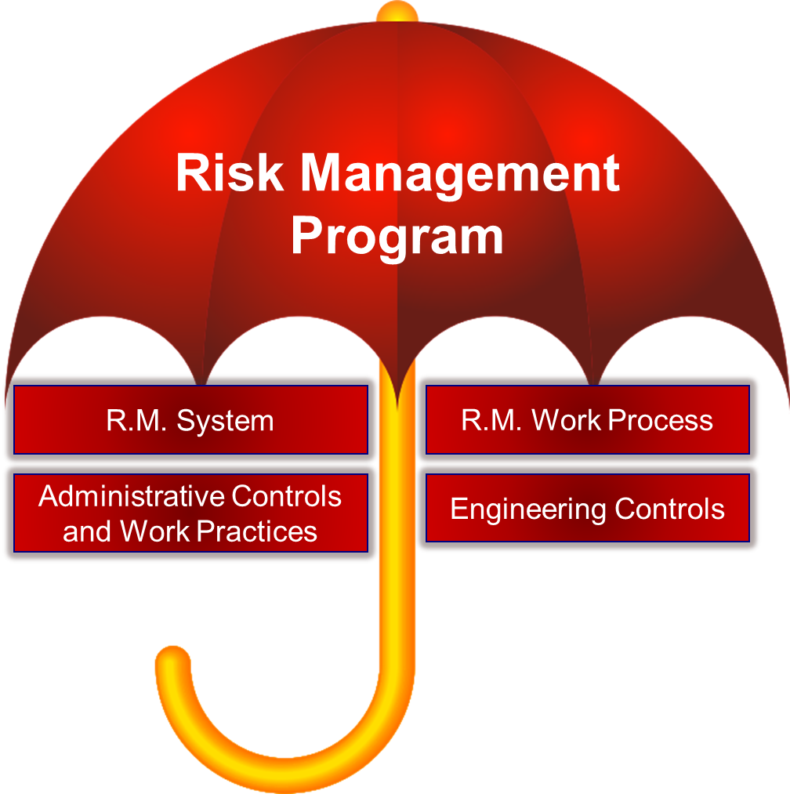
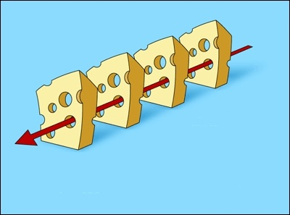
Introduction – Examine The Components of the RM Program:
The Block of Swiss Cheese and the Slices:
The Risk Management Program
Risk Management System
Engineering Controls
Administrative Controls
Work Practices
Chapter 4.4: The Swiss Cheese Model of a Loss Incident

Slide 5

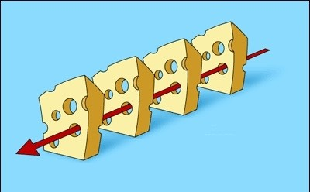
A Fresh Perspective: The Block of Swiss Cheese
The “Swiss Cheese” Model of a Loss Incident:
Consider the block of cheese and the set of cheese slices as your facility’s Risk Management Program.
The slices of cheese are successive safeguards (i.e. control measures, control mechanisms or barriers) to prevent a loss incident.
If the safeguards are deficient, as depicted by “holes”, an incident will occur.
Chapter 4.4: The Swiss Cheese Model of a Loss Incident

Slide 6
A Fresh Perspective: The Block of Swiss Cheese
The “Swiss Cheese” Model of a Loss Incident:
Now consider the red arrow, wherein some kind of activity is planned, with its inherent hazards and risks and with the intention of a successful outcome.
Planned activity and its hazards & risks …
and a successful outcome is intended.
Successful outcome?
Chapter 4.4: The Swiss Cheese Model of a Loss Incident

Slide 7

A Fresh Perspective: The Block of Swiss Cheese
The “Swiss Cheese” Model of a Loss Incident:
The Risk Management Program is applied (1,2,3,4) to control the hazards and reduce the risks associated with the planned activity to an acceptable level; where: 1) Risk Management System; 2) Engineering Controls; 3) Administrative Controls; 4) Work Practices.
1
2
Planned activity and its hazards & risks
3
X
D
4
X
X
X
Successful outcome
Successive levels of effective control measures
Chapter 4.4: The Swiss Cheese Model of a Loss Incident

Slide 8
A Fresh Perspective: The Block of Swiss Cheese
The “Swiss Cheese” Model of a Loss Incident:
Risk Management System Elements(where weaknesses in these are latent causes)
Engineering Controls (engineering systems in design, construction, operation, maintenance)
Administrative Controls (documented procedures – what workers are supposed to be doing), and
Work Practices (what workers are actually doing).
1
2
Planned activity and its hazards & risks
3
X
D
4
X
X
X
Successful outcome
Successive levels of effective control measures
Chapter 4.4: The Swiss Cheese Model of a Loss Incident

Slide 9
A Fresh Perspective: The Block of Swiss Cheese
The “Swiss Cheese” Model of a Loss Incident:
When the risk management program is implemented effectively, i.e. all safeguards and control measures are working, then there is a successful outcome to the planned activity, and loss incidents are prevented.
1
2
Planned activity and its hazards & risks
3
X
4
X
X
X
Successful outcome
Successive levels of effective control measures
Chapter 4.4: The Swiss Cheese Model of a Loss Incident

Slide 10

A Fresh Perspective: The Block of Swiss Cheese
The “Swiss Cheese” Model of a Loss Incident:
The implementation of a Risk Management Program maintains the effectiveness of all control measures.
1
2
Planned activity and its hazards & risks
3
X
D
4
X
Effective Implementation of a Risk Management Program
X
X
Successful outcome
Successive levels of effective control measures
Chapter 4.4: The Swiss Cheese Model of a Loss Incident

Slide 11
A Fresh Perspective: The Block of Swiss Cheese
The “Swiss Cheese” Model of a Loss Incident:
When there are weaknesses in the Risk Management Program – the program implementation is defective or ineffective – then there are breakdowns in the engineering controls, the administrative controls, and the work-practices, as represented by the holes in the cheeses slices.
1
2
Planned activity and its hazards & risks …
and a successful outcome is intended.
3
4
Successful outcome?
Breakdowns in safeguards and control measures, some due to active failures, some due to root causes.
Chapter 4.4: The Swiss Cheese Model of a Loss Incident

Slide 12
A Fresh Perspective: The Block of Swiss Cheese
The “Swiss Cheese” Model of a Loss Incident:
It is only a matter of time (probability, likelihood, chance, luck) before all of the breakdowns in the engineering controls, administrative controls, and work practices happen at the same time – these align – and a loss incident happens.
1
2
Planned activity and its hazards & risks
3
4
D
Loss Incident
Breakdowns in control measures, ultimately due to root causes.
Chapter 4.4: The Swiss Cheese Model of a Loss Incident

Slide 13
A Fresh Perspective: The Block of Swiss Cheese
The “Swiss Cheese” Model of a Loss Incident:
After the root cause analysis is completed and the recommendations that address the root cause(s) are effectively implemented, then the effectiveness of the implementation of the Risk Management Program is restored, and planned activities can be undertaken with successful outcomes.
1
2
Planned activity and its hazards & risks
3
X
4
X
D
Effective Implementation of a Risk Management Program
X
X
Successful outcome
Successive levels of effective control measures
Chapter 4.4: The Swiss Cheese Model of a Loss Incident

Slide 14
Chapter 4.5:
Linking Root Causes to the Recommendations
14
Notes:
ENGG404 Lecture 00 - Day 1
2012 Fall
14
14

Slide 15
Introduction – The Construct of an RCA:
A basic framework to understand the construct of a root cause analysis.
Type of Cause
Causes in the Root Cause Analysis
Category of Cause
Chapter 4.5: Linking Root Causes to the Recommendations
15

Slide 16
Introduction – The Construct of an RCA:
Type of Cause
Causes in the Root Cause Analysis
Category of Cause
Incident Description
Immediate Cause
Basic Cause
Latent Cause
Chapter 4.5: Linking Root Causes to the Recommendations
16

Slide 17
Introduction – The Construct of an RCA:
Type of Cause
Causes in the Root Cause Analysis
Category of Cause
Incident Description
Immediate Cause
Substandard Work Practice or Substandard Condition
Basic Cause
Engineering Factors Job Factors Personal Factors
Latent Cause
Inadequate Program Inadequate Standards Inadequate Compliance
Chapter 4.5: Linking Root Causes to the Recommendations
17

Slide 18
Introduction – The Construct of an RCA:
Type of Cause
Causes in the Root Cause Analysis
Category of Cause
Incident Description
Incident
Immediate Cause
Substandard Work Practice or Substandard Condition
Immediate Cause
Intermediate Cause
Basic Cause
Engineering Factors Job Factors Personal Factors
Basic Cause
Intermediate Cause
Latent Cause
Latent Cause
Inadequate Program Inadequate Standards Inadequate Compliance
Weakness in Management System Element #.
Recommendation?
Chapter 4.5: Linking Root Causes to the Recommendations
18

Slide 19
Examine a Root Cause:
Type of Cause
Causes in the Root Cause Analysis
Category of Cause
Incident Description
Equipment found in defective state
Immediate Cause
Industrial Mechanic (IM) did not follow / implement procedure
Sub-standard Work Practice
IM prioritized Mtce work on Prod’n Equipment over Safety Equipment
Basic Cause
IM had not yet learned or taken to heart or cared that or understood that safety checks must be done before Prod’n checks
Improper Risk Taking Improper Motivation
Management failed to communicate or failed to check that the IM understood Corporate Values: “Safety always before Production”
Latent Cause
Latent cause?
Inadequate Program
Colour coding is used here to emphasise cause types.
Colour coding is not necessary for your team project!
Chapter 4.5: Linking Root Causes to the Recommendations
19

Slide 20
Examine One Root Path in an RCA – Branch Improvements:
Consider these last two boxes. This root can be drawn better. Where do you see an opportunity to improve the root and what is it?
Equipment found in defective state
Industrial Mechanic (IM) did not follow / implement procedure
IM prioritized Mtce work on Prod’n Equipment over Safety Equipment
IM had not yet learned or taken to heart or cared that or understood that safety checks must be done before Prod’n checks
Management failed to communicate or failed to check that the IM understood Corporate Values: “Safety always before Production”
Chapter 4.5: Linking Root Causes to the Recommendations
20

Slide 21
Examine One Root Path in an RCA – Branch Improvements:
The word “OR” in the cause statement is replaced with an OR gate, and two roots result.
Equipment found in defective state
Industrial Mechanic (IM) did not follow / implement procedure
IM prioritised Mtce work on Prod’n Equipment over Safety Equipment
IM was not trained on Corporate Values
IM had not yet learned (i.e. cared for, understood) that safety checks must be done before Prod’n checks
Management failed to train IM on Corporate Values
Management failed to check that the IM understood Corporate Values: “Safety always before Production” as part of the communications plan.
Chapter 4.5: Linking Root Causes to the Recommendations
21

Slide 22
Examine Two Roots in an RCA: Latent Causes and Categories
Equipment found in defective state
Note the sub-category for the left root latent cause: because the training program exists (the cause states “not implemented”), so one could reasonably infer that this latent cause can be categorized as a “C – Inadequate Compliance with Program Standards”.
Industrial Mechanic (IM) did not follow / implement procedure
IM prioritised Mtce work on Prod’n Equipment over Safety Equipment
IM was not trained on Corporate Values
IM had not yet learned (i.e. cared for, understood) that safety checks must be done before Prod’n checks
Management failed to train IM on Corporate Values
Management failed to check that the IM understood Corporate Values: “Safety always before Production” as part of the communications plan.
The (existing) training program on Corporate Values was not implemented. (LC-C)
The management communications plan (program) did not include steps to check that new employees could explain Corporate Values. (LC-S)
Chapter 4.5: Linking Root Causes to the Recommendations
22

Slide 23
Examine Two Roots in an RCA: Latent Causes and Categories
Equipment found in defective state
Note the sub-category for the right root latent cause: because the communications plan lacked specific steps to check (and validate) training on Corporate Values, one could reasonably infer that the program exists, but the details (standard) were inadequate; thus, this latent cause can be categorized as an “S – Inadequate Program Standards”.
Industrial Mechanic (IM) did not follow / implement procedure
IM prioritised Mtce work on Prod’n Equipment over Safety Equipment
IM was not trained on Corporate Values
IM had not yet learned (i.e. cared for, understood) that safety checks must be done before Prod’n checks
Management failed to train IM on Corporate Values
Management failed to check that the IM understood Corporate Values: “Safety always before Production” as part of the communications plan.
The (existing) training program on Corporate Values was not implemented. (LC-C)
The management communications plan (program) did not include steps to check that new employees could explain Corporate Values. (LC-S)
Chapter 4.5: Linking Root Causes to the Recommendations
23

Slide 24
Examine One Root Path in an RCA: Latent Cause
Type of Cause
Causes in the Root Cause Analysis
Category of Cause
Note the Latent Cause is stated in unique and specific terms relevant to the loss incident RCA and is aligned with RMSE#1 MLCA
Incident Description
Equipment found in defective state
Immediate Cause
Industrial Mechanic (IM) did not follow / implement procedure
Sub-standard Work Practice
IM prioritized Mtce work on Prod’n Equipment over Safety Equipment
Basic Cause
IM had not yet learned (i.e. carunderstood) that safety checks must be done before Prod’n checks
Improper Risk Taking Improper Motivation
Management failed to check that the IM understood Corporate Values: “Safety always before Production” as part of the communications plan.
Latent Cause
The management communications plan (program) did not include steps to check that new employees could explain Corporate Values. (LC-S)
Inadequate Standard
RMSE #1) MLCA
Chapter 4.5: Linking Root Causes to the Recommendations
24

Slide 25
Examine One Root in an RCA: Latent Cause & Recommendation
Type of Cause
Causes in the Root Cause Analysis
Category of Cause
Incident Description
Equipment found in defective state
A recommendation to address this latent cause:
Improve the “Corporate Values” Communications Plan:
Confirm the organization has established corporate values
Include steps in the communications plan to confirm that new employees can explain the Corporate Values.
Implement a job observation audit system so management can confirm alignment to corporate values i.e. that the communications plan is effective.
Immediate Cause
Industrial Mechanic (IM) did not follow / implement procedure
Sub-standard Work Practice
IM prioritized Mtce work on Prod’n Equipment over Safety Equipment
Basic Cause
IM had not yet learned (i.e. carunderstood) that safety checks must be done before Prod’n checks
Improper Risk Taking Improper Motivation
Management failed to check that the IM understood Corporate Values: “Safety always before Production” as part of the communications plan.
Latent Cause
The management communications plan (program) did not include steps to check that new employees could explain Corporate Values. (LC-S)
Inadequate Standard
RMSE #1) MLCA
Recommendation!
Chapter 4.5: Linking Root Causes to the Recommendations
25

Slide 26
Test - Basic Cause or Latent Causes?
To test and identify when you have “drilled sufficiently deep” to identify the latent causes, use the categories and sub-categories from the C&E Model to check of you are at the latent cause, or still at a basic cause.
As will be seen (on page #33 “Effectiveness of Actions to Address Causes & Prevent Recurrence”), the nature of the recommendation can also reveal if you are at a latent cause or still at a basic cause.
Basic Cause
Engineering Factors Job Factors Personal Factors
4b
Basic Cause
5
1
Latent Cause
2
Latent Cause
Inadequate Program Inadequate Standards Inadequate Compliance
4a
Weakness in Management System Element #.
Recommendation?
3
Chapter 4.5: Linking Root Causes to the Recommendations
26

Slide 27
Example: What is the Recommendation?
LOSS INCIDENT
CATEGORIES
Petroleum fire
Incident description
Petrol released from pump casing
Intermediate
Pump casing corroded (failed)
IC: Sub-standard condition
Casing material was incompatible
intermediate
Improper material was used
intermediate
Pump design was incorrect
BC: Design – inadequate tech. design
The engineering work process / program to design pumps at this refinery was inadequate.
LC-P: RMSE#7 DC&SU
Chapter 4.2: Cause and Effect Models
Chapter 4.3: Root Cause Analysis of an Incident
27
Notes:
27

Slide 28
Note the Effectiveness of Actions on Causes to Prevent Recurrence:
LOSS INCIDENT
CORRECTIVE ACTIONS
Petroleum fire
Replace the pump. Note: This actions fixes the pump that failed, but not any other pumps in the refinery, now or in the future.
Petrol released from pump casing
NO PREVENTION
Pump casing corroded (failed)
Correct the design specification for pumps in this kind of process service.
Note: This action fixes the design for all pumps in this service, now and in the future, but not any pumps in other services.
Casing material was incompatible
Improper material was used
PREVENTS ONLY SAME SERVICE
Pump design was incorrect
Correct the work process for writing specifications / designing pumps for all pumps at this refinery.
Note: This fixes all designs for all pumps in all services.
The engineering work process / program to design pumps at this refinery was inadequate.
PREVENTS ALL PROCESS SERVICES
Chapter 4.5: Linking Root Causes to the Recommendations
28
Notes:
28

Slide 29
Chapter 4.6:
Tools for How to Develop & Prioritize Recommendations
29
Notes:
ENGG404 Lecture 00 - Day 1
2012 Fall
29
29

Slide 30
Developing Key Recommendations:
Any incident investigation / root cause analysis (your team project) will generate many possible risk reduction solutions.
Management (you) must carefully evaluate these ideas in order to determine which ones are practicable, can be effectively implemented, and be effective when implemented.
Your recommendations should be SMART: specific, measurable, actionable, realistic, and timely.
The process consists of these major steps:
Generate the Preliminary Recommendations.
Characterize and Prioritize the Recommendations.
Do a “Reality Check”.
Document the Recommendations.
Summarize the Recommendations.
1)-3) are a “work in progress”
Chapter 4.6: Tools for How to Develop & Prioritize Recommendations
30
Notes:
ENGG404 2015W
21-January-2015
30
30

Slide 31
The Challenge of Prioritizing Recommendations:
You have a number of possible actions / recommendations.
Which recommendations will you implement?
In what order will you implement them?
CONSIDER these objectives of implementing a recommendation:
Practicable
Useful & Feasible
Effective Once Implemented
Can be Successfully Implemented
Chapter 4.6: Tools for How to Develop & Prioritize Recommendations
31
Notes:
31

Slide 32
The Best Risk Reduction Solutions Are Those That Are:
Easiest to Implement
Lowest Cost to Implement
Quickest to Implement
Addresses Latent Causes
Most effective
Chapter 4.6: Tools for How to Develop & Prioritize Recommendations
32
Notes:
32

Slide 33
Consider “Effort”:
Best approach for quickly prioritizing actions of a straight-forward nature.
Generally want solutions with the lowest effort:
Simple or Known Technology
Low Cost
Low Effort
Short Duration
Quick to Implement
Chapter 4.6: Tools for How to Develop & Prioritize Recommendations
33
Notes:
33

Slide 34
Consider “Gain”:
Gain refers to:
The effectiveness of the solutions in addressing the causes (reducing the risk).
The solution that addresses latent causes is more effective than a solution that addresses basic causes or immediate causes.
Experts input: Typically, the persons with expertise and knowledge of the incident, the technology, the causes, and the scope and nature of the fix can make the best judgment on the effectiveness of the risk reduction solutions.
Chapter 4.6: Tools for How to Develop & Prioritize Recommendations
34
Notes:
34

Slide 35
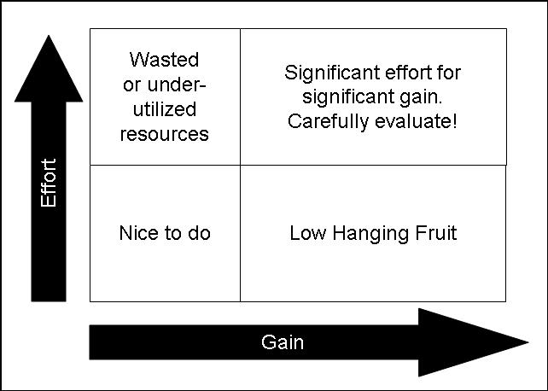
Method #1: the Simple Effort v Gain Illustrated:
Spending 10 hrs on an assignment that’s worth 0.5% of your mark
Chapter 4.6: Tools for How to Develop & Prioritize Recommendations
35
Notes:
35

Slide 36
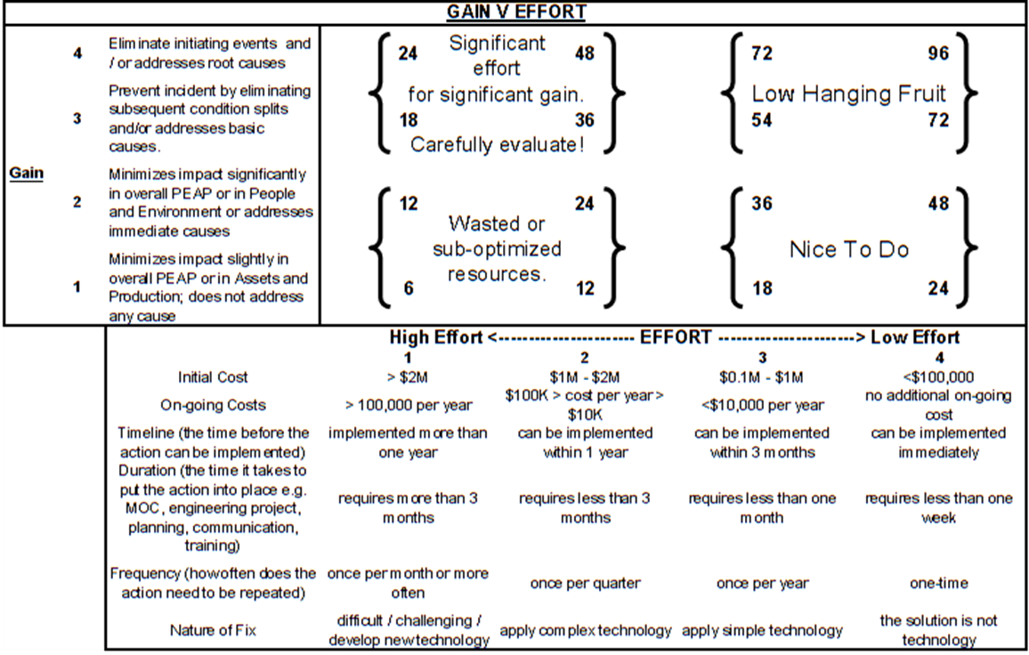
Method #2: The Complex Effort v Gain Tool: “Quantitative”
Chapter 4.6: Tools for How to Develop & Prioritize Recommendations
36
Notes:
36

Slide 37

Method #2: The Complex Effort v Gain Tool: “Quantitative”
GAIN
EFFORT
Chapter 4.6: Tools for How to Develop & Prioritize Recommendations
37
Notes:
37

Slide 38
Gain Index of The Complex Tool:
Gain Index | Gain Index Criteria (any one of or combination of):
4 | Addresses latent causes. Eliminates hazards or has the greatest reduction in risk levels. Eliminate initiating events.
3 | Addresses basic causes. Reduces risk levels to a lesser extent than “4”. Prevent incident by eliminating subsequent condition splits. Eliminates impact in overall PEAP despite having an event.
2 | Addresses immediate causes. Reduces risk levels to a lesser extent than “3”. Minimizes impact significantly in overall PEAP i.e. mitigates the consequence of an incident.
1 | Minimizes impact slightly in overall PEAP i.e. mitigates the consequence of an incident. Does not address any cause. Reduces risk levels to a lesser extent than “2”, or not at all.
Chapter 4.6: Tools for How to Develop & Prioritize Recommendations
38
Notes:
ENGG404 2015W
21-January-2015
38
38

Slide 39
Effort Index of The Complex Tool:
EFFORT INDEX | 1 (high effort) | 2 | 3 | 4 (low effort)
Practicability (Shown as “Nature of Fix” in the combined table.) | difficult / challenging / develop new technology | apply complex technology | apply simple technology | the solution is not technology
Initial Cost | > $2M | $1M - $2M | $0.1M - $1M | <$100,000
On-going Costs | > 100,000 per year | $100K > cost per year > $10K | <$10,000 per year | no additional on-going cost
Timeline (the time before the action can be implemented) | implemented more than one year | can be implemented within 1 year | can be implemented within 3 months | can be implemented immediately
Duration (the time it takes to put the action into place e.g. MOC, engineering project, planning, communication, training) | requires more than 3 months | requires less than 3 months | requires less than one month | requires less than one week
Frequency (how often does the action need to be repeated) | once per month or more often | once per quarter | once per year | one-time
Chapter 4.6: Tools for How to Develop & Prioritize Recommendations
39
Notes:
39

Slide 40
Example: Employee Training Program
Consider the risk reduction solution.
Gain: “4: Addresses latent causes.”
Effort: score of 18 (4+3+3+4+1+3)
The total score: 72 = 4 x 18.
EFFORT INDEX | 1 (high effort) | 2 | 3 | 4 (low effort)
Practicability | difficult / challenging / develop new technology | apply complex technology | apply simple technology | the solution is not technology
Initial Cost | > $2M | $1M - $2M | $0.1M - $1M | <$100,000
On-going Costs | > 100,000 per year | $100K > cost per year > $10K | <$10,000 per year | no additional on-going cost
Timeline (the time before the action can be implemented) | implemented more than one year | can be implemented within 1 year | can be implemented within 3 months | can be implemented immediately
Duration (the time it takes to put the action into place e.g. MOC, engineering project, planning, communication, training) | requires more than 3 months | requires less than 3 months | requires less than one month | requires less than one week
Frequency (how often does the action need to be repeated) | once per month or more often | once per quarter | once per year | one-time
Chapter 4.6: Tools for How to Develop & Prioritize Recommendations
40
Notes:
ENGG406 2015W
21-January-2015
40
40

Slide 41
Method #2: The Complex Effort v Gain Tool: “Quantitative”
The higher the score, the better!
Significant effort for significant gain. Carefully evaluate!
Low Hanging Fruit
Wasted or sub-optimized resources.
Nice To Do
Chapter 4.6: Tools for How to Develop & Prioritize Recommendations
41

Slide 42
Paralysis by Analysis: A Pitfall of Complex Ranking Tools:
Excessive time can be spent trying to accurately and precisely determine the likelihood and consequences.
This can detract from efforts to move forward with risk reduction solutions.
How do you balance the amount of time you spend on this?
The more expensive the solution, the more time and expertise needed to evaluate
“Value Engineering” and “Cost – Benefit Analysis”
Chapter 4.6: Tools for How to Develop & Prioritize Recommendations
42
Notes:
42

Slide 43
Work Process to Create the Set of Key Recommendations:
Recommendations are derived from your findings e.g. the latent causes from your RCA.
Recommendations should be: SMART
The work process consists of these major steps:
Generate the Preliminary Recommendations.
Prioritize and Characterize Each of the Recommendations. Here is where you use the Complex Effort vs Gain Tool.
Do a “Reality Check”.
Document the Recommendations.
Summarize the Recommendations.
Generate the Preliminary Recommendations.
Prioritize and Characterize the Recommendations.
Do a “Reality Check”
Document the Recommendations
1)-3) are a “work in progress”
Summarize the Recommendations
Chapter 4.6: Tools for How to Develop & Prioritize Recommendations
43
Notes:
ENGG404 2015W
21-January-2015
43
43

Slide 44
Summary:
The 4 successive barriers of the Swiss Cheese Model to a loss incident (in order of effectiveness) are:
RM System and Elements,
Engineering Controls,
Administration controls, and
Work Practices.
Latent causes are always linked to a relevant management system element.
The most effective recommendations for actions address or eliminate latent causes, rather than basic or immediate.
Prioritize recommendations for action using the complex gain versus effort tool.
Chapter 4.4: The Relationship Between Latent Causes & Incidents Chapter 4.5: Linking Latent Causes to Recommendations Chapter 4.6: Developing & Prioritizing Recommendations

